Slide 1
LOTHIAN LOCAL MEDICAL COMMITTEE AGM 2019
Chairs report
Dr A. Drummond Begg

Slide 2
Current situation?

Slide 3
SGPC negotiating aims
Improve being a GP
Improve recruitment and retention
Secure Income
Reduce workload
Reduce risk

Slide 4
Reduce workload
New services under Memo of Understanding
Services transferred from GMS to HSCPs in 2021
4 PCIPs agreed with Lothian LMC in 2018 – More detailed plans for Year 2 onwards to be agreed in June 2019 Plans must include funding and workforce required

Slide 5
Secure funding
New Workload Formula QOF funds secured Practice income guarantee (+£23M) Minimum GP income guarantee (~+£20M) Seniority – OOH - TRs

Slide 6
Reduce risk
Sustainability interest free loans at 20% value Boards to take over Premises leases Joint Data Sharing status in Regulations Agreement of Data Protection Officers

Slide 7
Recruitment and retention
WTE 3,735 in 2013 to 3,575 in 2017 Commitment to 800 GPs by 2028
Returners & Stay in practice scheme
Doctors support and advisory group
Undergraduate reform + campaign to reform postgraduate education

Slide 8
LOTHIAN LMC AIMS for 2019
Ensure rapid and effective use of new contract funds ‘in direct support of GP’
Ensure Lothian Health commitment to additional £5M fund to support GP maintained.
Ensure that the pledge to raise GP share of NHS funding to 11% by 2021 is kept. (6.8% in 2016)
Ensure that GP sub / Quality Clusters/ HSCPs have appropriate funding for developing Quality agenda post QoF & ensure tripartite working
Ensure that paperless prescribing occurs at the earliest opportunity
Ensure that the clinician ordering the test deals with the result – ‘stop duplication’ campaign.
Ensure that new work receives new resource – all plans should describe and cost the ‘GP impact factor’

Slide 9
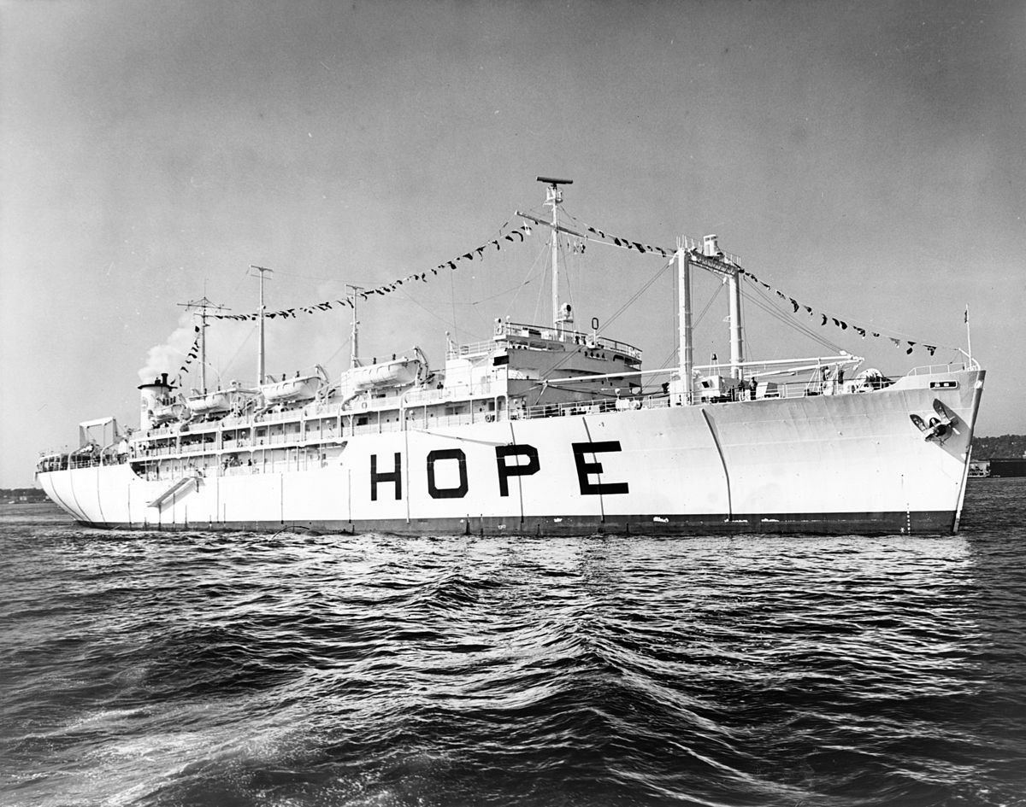
The future?

