Slide 1
GMS CONTRACT AND PRIMARY CARE TRANSFORMATION

Slide 2
INTRODUCTION – IT’S COMPLICATED
GMS IS A DELEGATED FUNCTION TO INTEGRATION JOINT BOARDS FOR STRATEGIC PLANNING PURPOSES
NHS BOARDS RETAIN RESPONSIBILITY FOR EMPLOYMENT, CONTRACTS, PREMISES, IT ETC
IN BOARDS WITH >1 INTEGRATION BOARD THE NHS BOARD HAS TO TAKE AN OVERVIEW FOR THE WHOLE POPULATION
IN LOTHIAN WE HAVE A MIXED ECONOMY:
IJBs PLAN
INDEPENDENT CONTRACTORS DELIVER
HSCPs DELIVER
NHS BOARD DELIVERS

Slide 3
SO WE HAVE A TRIPARTITE APPROACH
IJBs/HSCPS
NHS BOARD
GP SUB COMMITTEE
GMS OVERSIGHT GROUP AREAS OF RESPONSIBILITY = SHARED AREAS

Slide 4
AREAS FOR CHANGE AND INVESTMENT IN THE CONTRACT PHASE 1
PRACTICE FUNDING
WORKLOAD
PHARMACOTHERAPY
VACCINATIONS
URGENT CARE
ADDITIONAL PROFESSIONAL ROLES
COMMUNITY TREATMENT AND CARE SERVICES (CTACS)
LINKS WORKERS
PREMISES
PREMISES LOANS
PREMISES LEASES

Slide 5
PRACTICE FUNDING
 | 2018/19
NATIONAL INCREASE | 23M
LOTHIAN INCREASE | 3.7M (16%)
LOTHIAN PRACTICES GETTING AN INCREASE | 91
LOTHIAN PRACTICES PROTECTED | 30
EAST PROTECED | 2
EDINBURGH PROTECTED | 26
MIDLOTHIAN PROTECTED | 3
WEST LOTHIAN PROTECTED | 0

Slide 6
TRANSFORMATION FUNDING
 | 18/19 | 19/20 | 20/21 | 21/22
PCIF LOTHIAN* | 6.7 | 8.1 | 16.3 | 22.9
NHSL INVESTMENT | 4.0 | 5.0 | 5.0 | 5.0
TOTAL | 10.7 | 13.1 | 21.3 | 27.9
EAST LOTHIAN | 1.3 | 1.6 | 2.6 | 3.4
EDINBURGH | 6.1 | 7.5 | 12.1 | 15.9
MIDLOTHIAN | 1.1 | 1.3 | 2.1 | 2.8
WEST LOTHIAN | 2.3 | 2.8 | 4.5 | 5.9
*BASED ON PROJECTIONS 19/20 TO 21/22 – ALLOCATIONS NOT CONFIRMED

Slide 7
THE NEW CONTRACT
FUNDING REPLACES PREVIOUS NATIONAL FUNDING FOR:
Pharmacy teams in General Practice
Vaccination Transformation Programme
Primary Care Transformation Fund
Community Links Workers
Mental Health Primary Care Fund
Pharmacy First
PLUS OTHER LOTHIAN COMMITMENTS ALREADY MADE
Diabetes
Phlebotomy
Advanced Nurse Practitioner Training

Slide 8
TRANSFORMATION FUNDING – PROPOSED USES - ALL HSCPS (OCT ’18)
AREA | 2021/22
VACCINATIONS | 1.2M
PHARMACOTHERAPY | 4.2M
CTACS | 4.1M *
URGENT CARE | 2.9M
ADDITIONAL PROFESSIONAL ROLES | 4.3M
LINKS WORKERS | 2.3M
OTHER | 0.7M
TOTAL | 19.7M !
* INCLUDES EAST LOTHIAN URGENT CARE AND ADDITIONAL PROFESSIONAL ROLES
! DOES NOT EXACTLY MATCH ASSSUMED ALLOCATION ON SLIDE 6 – WILL BE UPDATED
ONCE ALLOCATION IS KNOWN AND PLANS UPDATED

Slide 9
OVERALL WORKFORCE CHANGE EAST LOTHIAN EXAMPLE – 2021/22
TOTAL
51.4
TOTAL
51.4
URGENT CARE
15.8 WTE
CTACS
12 WTE
VACCINATION
5 WTE
ADDITIONAL PROFESSIONAL ROLES MENTAL HEALTH
4 WTE
PHARMACOTHERAPY 9.6 WTE
LINK WORKERS
5 WTE

Slide 10
OVERALL WORKFORCE CHANGE – EDINBURGH EXAMPLE
YEAR 3
 | Job Family | Year 1 2018/19 (WTE) | Year 1 2018/19 (£) | Year 2 2019/20 (WTE) | Year 2 2019/20 (£) | Year 3 2020/21 (WTE) | Year 3 2020/21 (£)
Vaccination Services
Band 3 | Nursing |  | 0 |  | 0 |  | 0
Band 4 | Nursing |  | 0 |  | 0 |  | 0
Band 5 | Nursing | 4 | 159,659 | 8 | 328,897 | 17 | 719,873
Band 6 | Nursing |  | 0 |  | 0 |  | 0
Band 7 | Nursing |  | 0 |  | 0 |  | 0
Total |  | 4 | 159,659 | 8 | 328,897 | 17 | 719,873
Pharmacotherapy Services
Band 3 | Pharmacy |  | 0 |  | 0 |  | 0
Band 4 | Pharmacy |  | 0 |  | 0 |  | 0
Band 5 | Pharmacy |  | 0 | 10 | 411,121 | 20 | 846,909
Band 6 | Pharmacy |  | 0 |  | 0 |  | 0
Band 7 | Pharmacy | 20 | 1,082,849 | 30 | 1,673,002 | 35 | 2,010,390
Band 8 | Pharmacy |  | 0 |  | 0 |  | 0
Total |  | 20 | 1,082,849 | 40 | 2,084,123 | 55 | 2,857,300
Community Treatment & Care Services
HCSW/Phlebotomists
Band 2 | Nursing |  | 0 | 5 | 118,195 | 7 | 170,437
Band 3 | Nursing |  | 0 | 5 | 127,047 | 8 | 209,373
Treatment Room Nurses
Band 4 | Nursing |  | 0 |  | 0 |  | 0
Band 5 | Nursing | 2 | 79,829 | 20 | 822,242 | 20 | 846,909
Band 6 | Nursing | 1 | 46,266 | 4 | 190,617 | 4 | 196,336
Total |  | 3 | 126,096 | 34 | 1,258,101 | 39 | 1,423,055
Urgent Care Services (PA/SPP/DN/ANP)
Physician Associates
Band 6 | AMP |  | 0 |  | 0 |  | 0
Band 7 | AMP |  | 0 | 4 | 223,067 | 8 | 459,518
Specialist Paramedics
Band 6 | AHP |  | 0 |  | 0 |  | 0
Band 7 | AHP |  | 0 | 4 | 223,067 | 10 | 574,397
District Nursing/ANPs
Band 6 | Nursing |  | 0 |  | 0 |  | 0
Band 7 | Nursing | 8 | 433,140 | 16 | 892,268 | 21 | 1,206,234
Total |  | 8 | 433,140 | 24 | 1,338,401 | 39 | 2,240,149
Additional Professional Services
Community Mental Health
CPN
Band 5 | Nursing |  | 0 |  | 0 |  | 0
Band 6 | Nursing | 17 | 786,527 | 25 | 1,191,357 | 29 | 1,423,434
Band 7 | Nursing | 3 | 162,427 | 4 | 223,067 | 4 | 229,759
Occupational Therapy
Band 5 | AHP |  | 0 |  | 0 |  | 0
Band 6 | AHP |  | 0 |  | 0 |  | 0
Psychological Therapist
Band 7 | Other Therapeutic |  | 0 |  | 0 |  | 0
Total |  | 20 | 948,955 | 29 | 1,414,424 | 33 | 1,653,193
Physiotherapy - MSK
Band 5 | AHP |  | 0 |  | 0 |  | 0
Band 6 | AHP |  | 0 |  | 0 |  | 0
Band 7 | AHP | 4 | 216,570 | 6 | 334,600 | 16 | 919,036
Band 8 | AHP | 0.5 | 31,389 | 0.5 | 32,330 | 0.5 | 33,300
Total |  | 4.5 | 247,958 | 6.5 | 366,931 | 16.5 | 952,336
Link Workers
Band 4 Equivalent | 3rd Sector | 16 | 463,305 | 20 | 596,505 | 25 | 768,000
Total |  | 16 | 463,305 | 20 | 596,505 | 25 | 768,000
Grand Total |  | 75.5 | 3,461,961 | 161.5 | 7,387,382 | 224.5 | 10,613,906
17 WTE IN VACCINATIONS
55 WTE IN PHARMACOTHERAPY
39 WTE IN CTACS
39 WTE IN URGENT CARE
33 WTE IN ADDITIONAL PROFESSIONAL ROLES
224 WTE IN TOTAL
224 WTE IN TOTAL

Slide 11
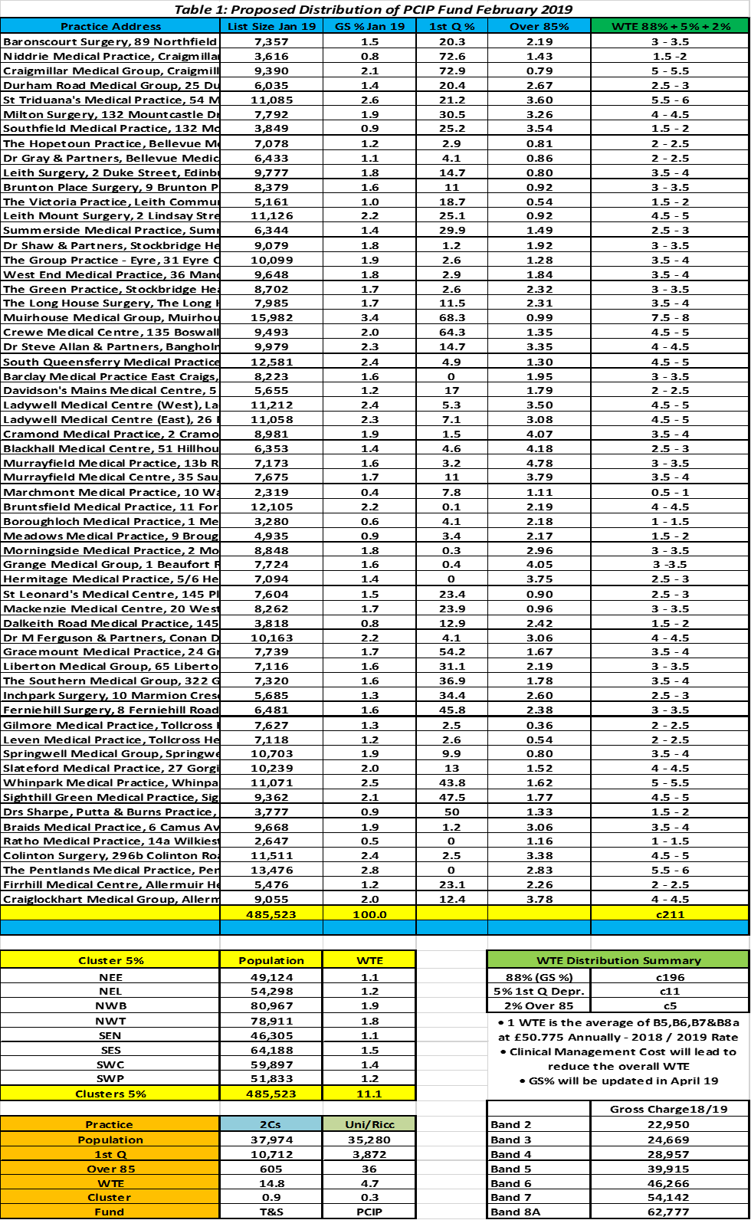
INDIVIDUAL PRACTICE SUPPORT – EDINBURGH EXAMPLE
RANGE OF WTE PER PRACTICE AT END OF IMPLEMENTATION
E.G. STOCKBRIDGE GREEN PRACTICE : 3 TO 3.5 WTE
THE NUMBERS ARE ESTIMATES AND MAY VARY BASED ON FINANCIAL ALLOCATIONS, WORKFORCE AVAILABILITY, PILOT EVALUATIONS

Slide 12
2018/19 PROGRESS –SOME EXAMPLES
CPNs in EDINBURGH
PRACTICE STABILITY PROGRAMME IN EDINBURGH
PARAMEDICS IN WEST LOTHIAN
MENTAL HEALTH HUBS IN WEST LOTHIAN
PILOT CTACS IN EDINBURGH
ADDITIONAL MSK INPUT BY PHYSIO IN ALL HSCPs
SIGNPOSTING TRAINING FOR PRACTICE STAFF IN WEST LOTHIAN
PHARMACISTS IN ALL HSCPs
WELLBEING SERVICE IN MIDLOTHIAN
0-5 IMMUNISATIONS REMOVED FROM ALL PRACTICES BY END MARCH 2019
INTEREST FREE LOANS AGREED
5 LEASES BEING TAKEN OVER
CWIC IN EAST LOTHIAN
“DO I NEED TO SEE A GP?” MIDLOTHIAN
CARE HOME TEAM IN EAST LOTHIAN

Slide 13
EXAMPLE STEPS IN 2019/20
PLAN TRANSFER OF REST OF IMMUNISATIONS FOR 20/21
EXPAND NURSE PRACTITIONER TRAINING
CONTINUE TO DEPLOY ADDITIONALNURSES AND CPNs TO PRACTICES
ESTABLISHMENT OF HSCP VACCINATION CAPACITY
ACROSS LOTHIAN
IMPLEMENT CORE CTACS INFRASTRUCTURE
NEXT PHASE OF PHARMACIST RECRUITMENT
EXPAND ADVANCED PRACTICE PHYSIOTHERAPIST TRAINING
ROLL OUT MENTAL HEALTH HUBS (WEST)
CONTINUE TO DEPLOY ADDITIONAL PHYSIOTHERAPISTS INTO MSK ROLES
HEALTH AND SOCIAL CARE PARTNERSHIPS
STAGE 2 OF INTEREST FREE LOANS
E HEALTH PRIORITIES
CWIC EXPANSION (EAST)
LOCAL CTACS (EAST AND EDINBURGH)
NEXT STAGE OF LEASES TO BE TAKEN ON
PLAN AND IMPLEMENT LOTHIAN WIDE RECRUITMENT
PHARMACIST DEPLOYMENT TO PRACTICES
FURTHER DEVELOP MENTAL HEALTH SUPPORT IN MIDLOTHIAN

