Slide 1
Annual General Meeting of Lothian Local Medical Committee Ltd Evidence for the new GP contract?
Stewart Mercer
Professor of Primary Care and Multimorbidity
Director of the Scottish School of Primary Care
University of Edinburgh
Stewart.Mercer@ed.ac.uk

Slide 2
Transforming Primary Care
“My vision puts primary and community care at the heart of the healthcare system, with highly skilled multidisciplinary teams delivering care both in and out of hours, and a wide range of services that are tailored to each local area. That care will take place in locality clusters, and our primary care professionals will be involved in the strategic planning of our health services. The people who need healthcare will be more empowered and informed than ever, and will take control of their own health. They will be able to directly access the right professional care at the right time, and remain at or near home wherever possible.”
Shona Robison, Scottish Parliament, 15 December 2015
“We will transform primary care, delivering a new Community Health Service with a new GP contract, increased GP numbers and new multi-disciplinary community hubs.” SNP Manifesto, May 2016

Slide 4
Transforming primary care
“new world”
transition
performance
“old world”
2016
2017
2020
time
From a prescriptive contract to an enabling contract

Slide 5
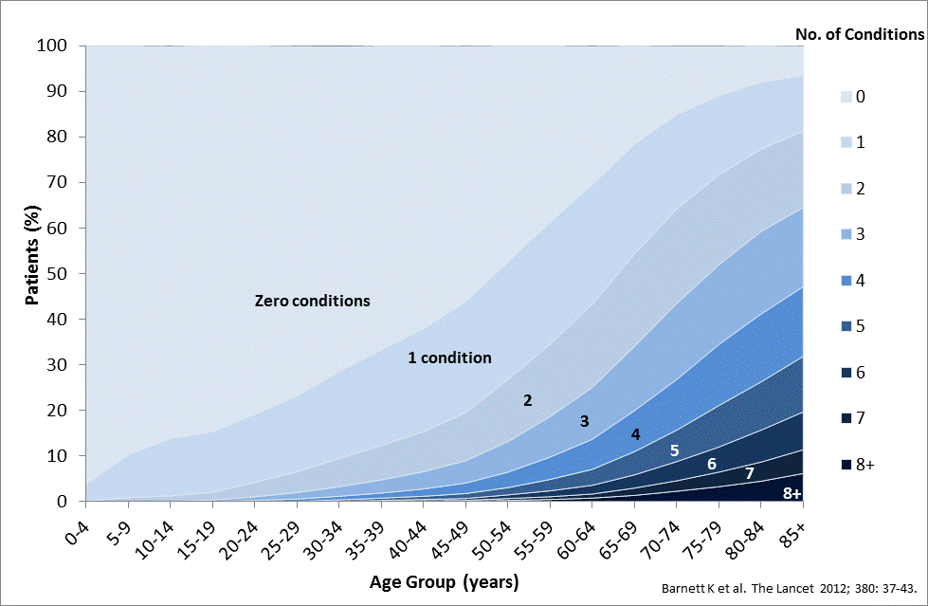
Multimorbidity in Scotland
The majority of over-65s have 2 or more conditions, and the majority of over-75s have 3 or more conditions

Slide 6
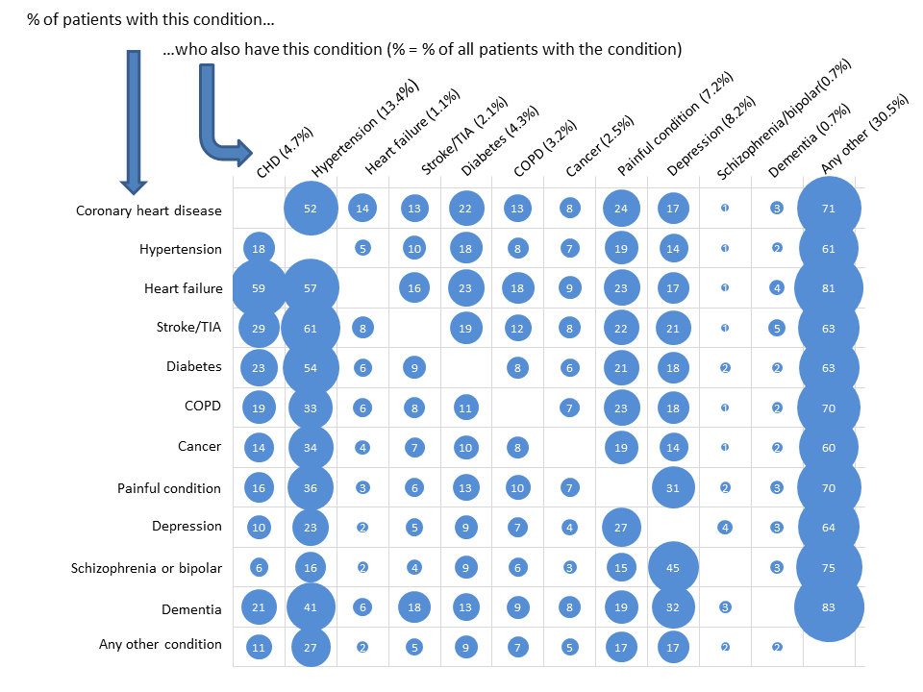
Most people with any long term condition have multiple conditions in Scotland
Guidelines and organisation of care do not reflect this reality
Guthrie B et al, BMJ 2012;345:e6341; Hughes L et al, Age and Ageing 2013;42:62-69

Slide 7
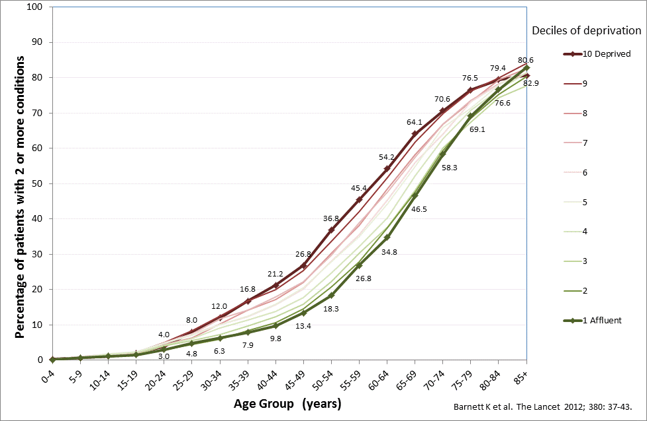
Multimorbidity is socially patterned People living in the poorest areas in develop multimorbidity 10-15 years before those living in rich areas

Slide 8
Core changes and ambitions of the new GP contract
The end of QOF
GP Clusters
Intrinsic role
Extrinsic role
Wider MDT
Advanced nurse practitioners (ANPs)
Musculoskeletal Physiotherapists (MSK-P)
Community Pharmacists
Community Link workers
Longer consultations for patients with complex multimorbidity

Slide 9
GP Clusters
Not entirely clear where this idea came from
Europe has had some thing similar -Quality Circles- for the last 20 years or so.
SSPC produced a Briefing Paper entitled ‘Collaborative Quality Improvement in GP Clusters’ in August 2017 based on an international systematic literature review by Dr Adrian Rohrbasser.
(http://www.sspc.ac.uk/media/media_543940_en.pdf

Slide 10
International evidence: Clusters can be effective…..
Good evidence that QCs can improve Quality– in use of diagnostic tests, prescribing, chronic disease management, unexplained variations in practice
Interventions used by QCs include: educational material, audit and feedback, PDSA cycles, use of local knowledge ‘experts’
Choice of intervention tools depends on LOCAL decisions/ context

Slide 11
Characteristics of successful Clusters
Friendly relaxed atmosphere, build in social interaction, arrange in a circle whenever possible
Core QI knowledge and skills crucial: introduce basic principles like PDSA
Availability of data and support with analysis and interpretation
Agree on topic(s). Balance between central direction and local autonomy. Move from simple to complex
Use tacit GP knowledge about a topic & integrate with wider knowledge/ evidence
Local leadership essential

Slide 12
Facilitation is critical (CQL role)
Create openness and mutual trust
Balance comfort and challenge in the group
Allow everyone to have their say; empathically support less vocal/articulate members
Facilitate expression of local tacit knowledge as well as wider evidence ( guidelines et)
Resolve conflicts when needed
Finish on time!

Slide 13
Improving Together: A National Framework for Quality and GP Clusters in Scotland set out the intrinsic and extrinsic functions of clusters as follows:
Intrinsic | Extrinsic
Learning network, local solutions, peer Support | Collaboration and practice systems working with Community MDT and third sector partners
Consider clinical priorities for collective Population | Participate in and influence priorities and strategic plans of Integrated Authorities
Transparent use of data, techniques and tools to drive quality improvement – will, ideas, execution | Provide critical opinion to aid transparency and oversight of managed services
Improve wellbeing, health and reduce health inequalities | Ensure relentless focus on improving clinical outcomes and addressing health inequalities

Slide 14
Wider MDT – International Evidence: Advanced Nurse Practitioners
Recent systematic reviews suggest that ANPs and other types of nurse practitioners can substitute for GPs for a range of acute and chronic conditions, with similar or better outcomes, and higher patient satisfaction.
However, nurse consultations are generally longer than GPs. The cost-effectiveness of ANPs remains unclear.
Most studies excluded patients with mental health problems.

Slide 15
References
Laurant M, van der Biezen M, Wijers N, Watananirun K, Kontopantelis E, van Vught AJAH. Nurses as substitutes for doctors in primary care. Cochrane Database of Systematic Reviews 2018, Issue 7. Art. No.: CD001271. DOI: 10.1002/14651858.CD001271.pub3.
wan M, et al. Quality of primary care by advanced practice nurses: a systematic review. International Journal for Quality in Health Care 2015, 27(5): 396-404
Horrocks S, et al. Systematic review of whether nurse practitioners working in primary care can provide equivalent care to doctors. BMJ 2002, 324(7341): 819-823.

Slide 16
Wider MDT – International Evidence: MSK Physiotherapy
MSK Physiotherapists are a safe and efficient replacement for GPs as first point of contact for patients with MSK conditions.
They reduce re-consultation rates with GPs and reduce needless referrals to secondary care physiotherapy or orthopaedics.
They are generally well received by patients.
Overall, they appear to be a cost-effective alternative to the GP via a reduction in contact time, a reduction in prescriptions, less imaging costs and reduced needless referral into secondary care.

Slide 17
References
Marks, D., et al., Substitution of doctors with physiotherapists in the management of common musculoskeletal disorders: a systematic review. Physiotherapy, 2017. 103(4): p. 341-351.
Desmeules, F., et al., Advanced practice physiotherapy in patients with musculoskeletal disorders: a systematic review. 2012. 13(1): p. 107.
Holdsworth, L.K., et al., What are the costs to NHS Scotland of self-referral to physiotherapy? Results of a national trial. 2007. 93(1): p. 3-11.
Hattam, P. and A.J.B.J.o.C.G. Smeatham, Evaluation of an orthopaedic screening service in primary care. 1999. 4(2): p. 45-49.
Desjardins-Charbonneau, A., et al., Acceptability of physiotherapists as primary care practitioners and advanced practice physiotherapists for care of patients with musculoskeletal disorders: a survey of a university community within the province of Quebec. 2016. 17(1): p. 400.
Webster, V.S., et al., Self-referral, access and physiotherapy: patients’ knowledge and attitudes—results of a national trial. Physiotherapy, 2008. 94(2): p. 141-149.
Goodwin, R.W., P.A.J.P.h.c.r. Hendrick, and development, Physiotherapy as a first point of contact in general practice: a solution to a growing problem? 2016. 17(5): p. 489-502.

Slide 18
Wider MDT – International Evidence: Community Pharmacists
Pharmacists conducting medication reviews reduce potentially inappropriate prescribing (PIP) in older adults, which is likely to improve patient health and reduce the costs of adverse events.
Pharmacist intervention reduces a range of medication errors when patients on known high risk prescribing regimens are targeted.
Pharmacist involvement in medication reviews in nursing homes has been shown to reduce falls, and reduce PIP.
http://www.sspc.ac.uk/media/media_484733_en.pdf
http://www.sspc.ac.uk/media/media_617129_en.pdf

Slide 19
References
Clyne B, Fitzgerald C, Quinlan A, Hardy C, Galvin R, Fahey T, Smith SM. 2016. Interventions to Address Potentially Inappropriate Prescribing in Community-Dwelling Older Adults: A Systematic Review of Randomized Controlled Trials. Journal of the American Geriatrics Society. 64(6):1210-22.
Avery, Anthony J., Rodgers, Sarah, Cantrill, Judith A., Armstrong, Sarah, Cresswell, Kathrin, Eden,Martin, Elliott, Rachel A, Howard, Rachel, Kendrick, Denise, Morris, Caroline J, Prescott, Robin J, Swanwick, Glen, Franklin, Matthew, Putman, Koen, Boyd, Matthew, Sheikh, Aziz A pharmacist-led information technology intervention for medication errors (PINCER): a multicentre, cluster randomised, controlled trial and cost-effectiveness analysis (2012) Lancet; 379: 1310–19
Lowrie R, Lloyd SM, McConnachie A, Morrison J (2014) A Cluster Randomised Controlled Trial of a Pharmacist-Led Collaborative Intervention to Improve Statin Prescribing and Attainment of Cholesterol Targets in Primary Care. PLoS ONE 9(11): e113370. doi:10.1371/journal.pone.0113370
Zermansky AG, Alldred DP, Petty DR, et al. Clinical medication review by a pharmacist of elderly people living in care homes--randomised controlled trial. Age Ageing 2006;35(6):586-91

Slide 20
Wider MDT – International Evidence: Community Link Workers
Social prescribing has become popular with policy makers as a potential way of reducing health inequalities
There is an absence of high quality research evidence to support this
The Deep End Link Worker Project evaluation is the largest RCT to date.
There was no evidence of improved outcomes for any of the measures (QOL, Wellbeing, MH, lifestyle) on Intention-to-Treat analysis
http://www.healthscotland.com/documents/29438.aspx

Slide 21
Longer consultations for patients with complex multimorbidity
GP consultation length varies widely internationally.
Cochrane Review highlights ‘absence of evidence’ for benefits of longer GP consultations
More recent SR suggest benefit for patients with psychosocial problems
Consultation shorter in deprived areas due to the inverse care law
Patients with multimorbidity in Scotland have 40% longer consultations than other patients in affluent areas, but not in deprived areas

Slide 22
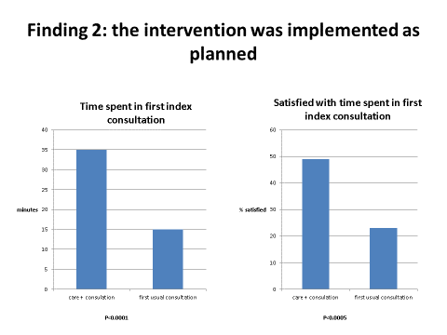
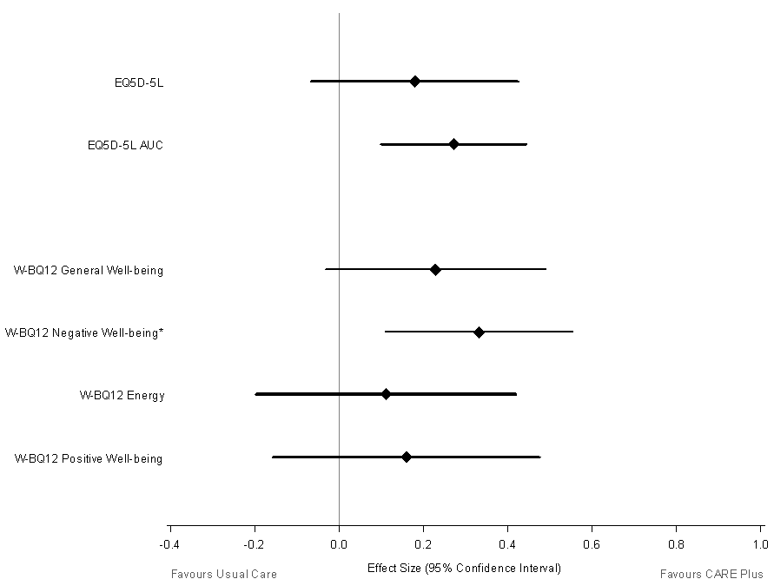
CARE Plus: longer consultation in Deep End Practices for targeted younger multimorbid patients (30-64 years)

Slide 23
3D Study: longer consultations as part of a comprehensive review in multimorbid patients with 3 or more QOF conditions (average 70 yrs)
No effect of any of the outcome measures:
Quality of life
Depression
Anxiety
Polypharmacy
Illness burden
Treatment burden
But significant improvements in:
All measures of patient-centred care and patient satisfaction

Slide 24
References
Smith SM, Wallce E, O’Dowd T, Fortin M. Interventions for improving outcomes in patients with multimorbidity in primary care and community settings. Cochrane Database Syst Rev. 2016;3:Cd006560.
Barnett K, Mercer S, Norbury M, Watt G, Wyke S, Guthrie B. Epidemiology of multimorbidity and implications for healthcare, research, and medical education: a cross-sectional study. Lancet. 2012;380:37–43.
Wilson AD, Childs S. Effects of interventions aimed at changing the length of primary care physicians’ consultation. Cochrane Database Syst Rev. 2006;1:CD003540. doi:10.1002/14651858.CD003540.pub.2.
Hutton C, Gunn J. Do longer consultations improve the management of psychological problems in general practice? A systematic literature review. BMC Health Serv Res. 2007;7:71.
Salisbury C, Man M, Bower P, Guthrie B, Chaplin K, Gaunt D, Brookes S, Fitzpatrick B, Gardner , Hollinghurst S, Lee V, McLeod J, Mann C, Moffat K, Mercer SW. Improving the management of multimorbidity using a patient-centred care model: pragmatic cluster randomized trial of the 3D approach. The Lancet 2018, 392;10141, 41–50
Mercer SW, Fitzpatrick B, Guthrie B, Fenwick E, Grieve E, Lawson K, Boyer N, McConnachie A, Lloyd SM, O’Brien R, Watt GCM, Wyke S. The Care Plus study- a whole system intervention to improve quality of life of primary care patients with multimorbidity in areas of high socioeconomic deprivation: cluster randomised controlled trial. BMC Medicine 2016, 14:88

Slide 25
In summary: evidence for the new GP contract?
GP Clusters
Intrinsic role – yes (but)
Extrinsic role - no
Wider MDT
Advanced nurse practitioners (ANPs) -yes (but)
Musculoskeletal Physiotherapists (MSK-P)-yes (but)
Community Pharmacists- yes (but)
Community Link workers- no (but)
Longer consultations for patients with complex Multimorbidity (mixed)

